Slide 1
Spatial Facial Landmark Tracking for Automated Drowsiness Detection
A real-time computer vision system for driver safety monitoring
Presenter: M KASHI VISHWANATH
URK23EC4015

Slide 2
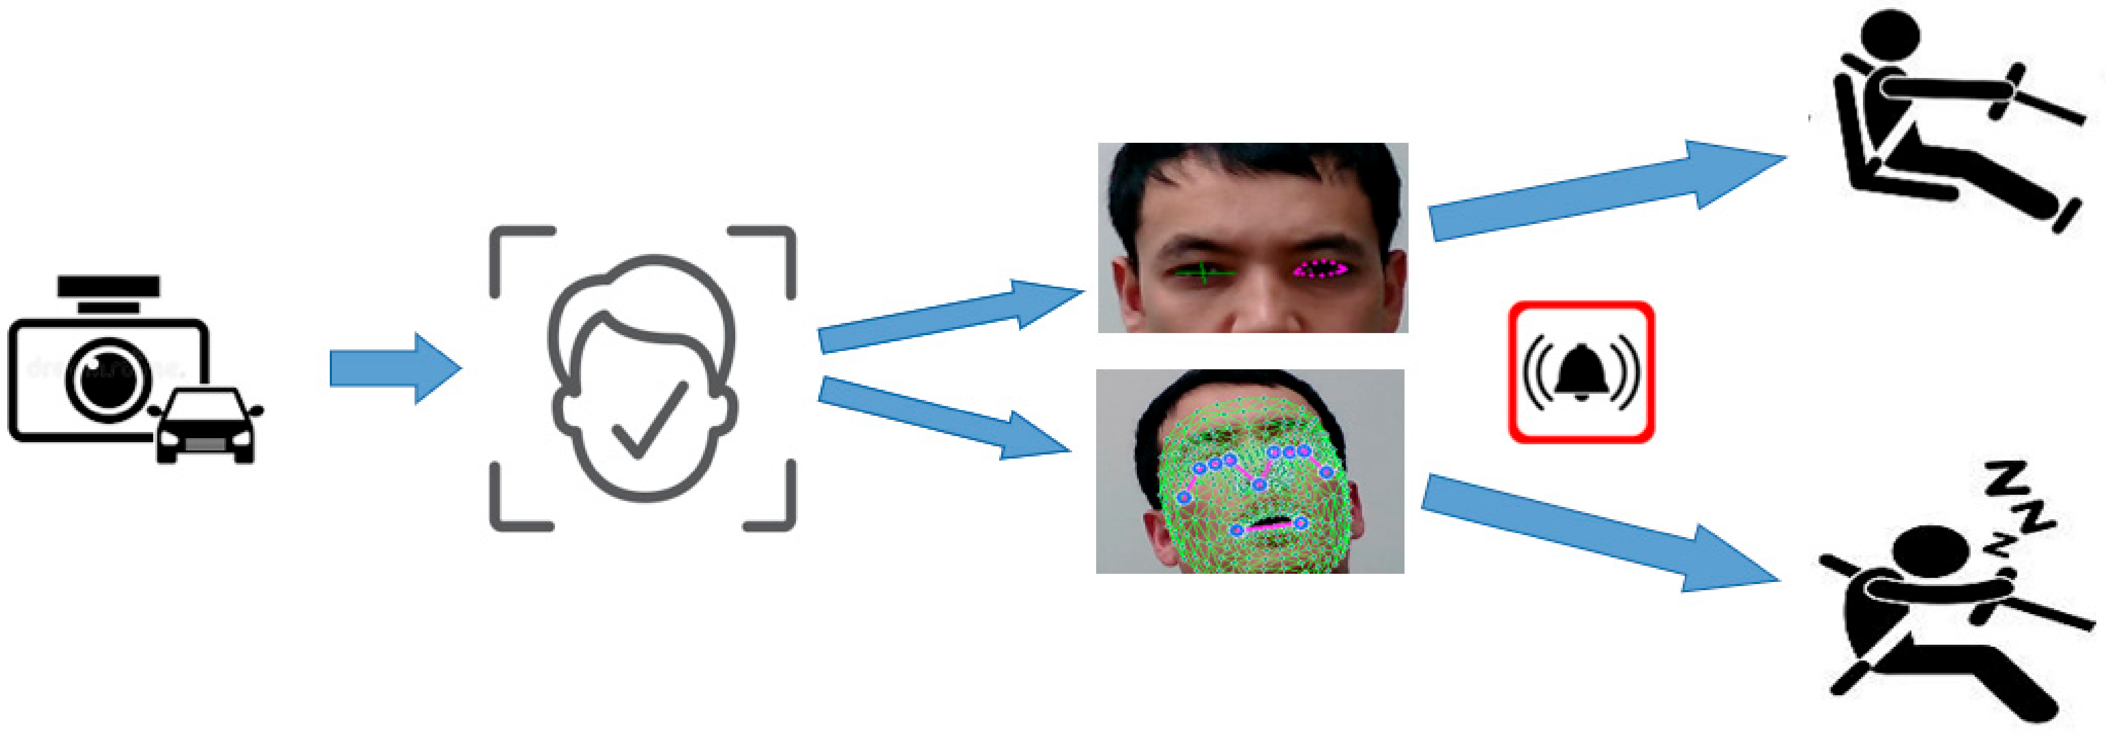
Problem Statement
The Issue: Fatigue and micro-sleeps are leading causes of severe road accidents.
The Gap: Many existing safety systems rely on vehicular behavior (lane drifting), which only detects danger after a driver has already lost focus.
The Goal: Build a proactive, non-intrusive monitoring system that evaluates the driver's biological state in real-time before an accident occurs.

Slide 3
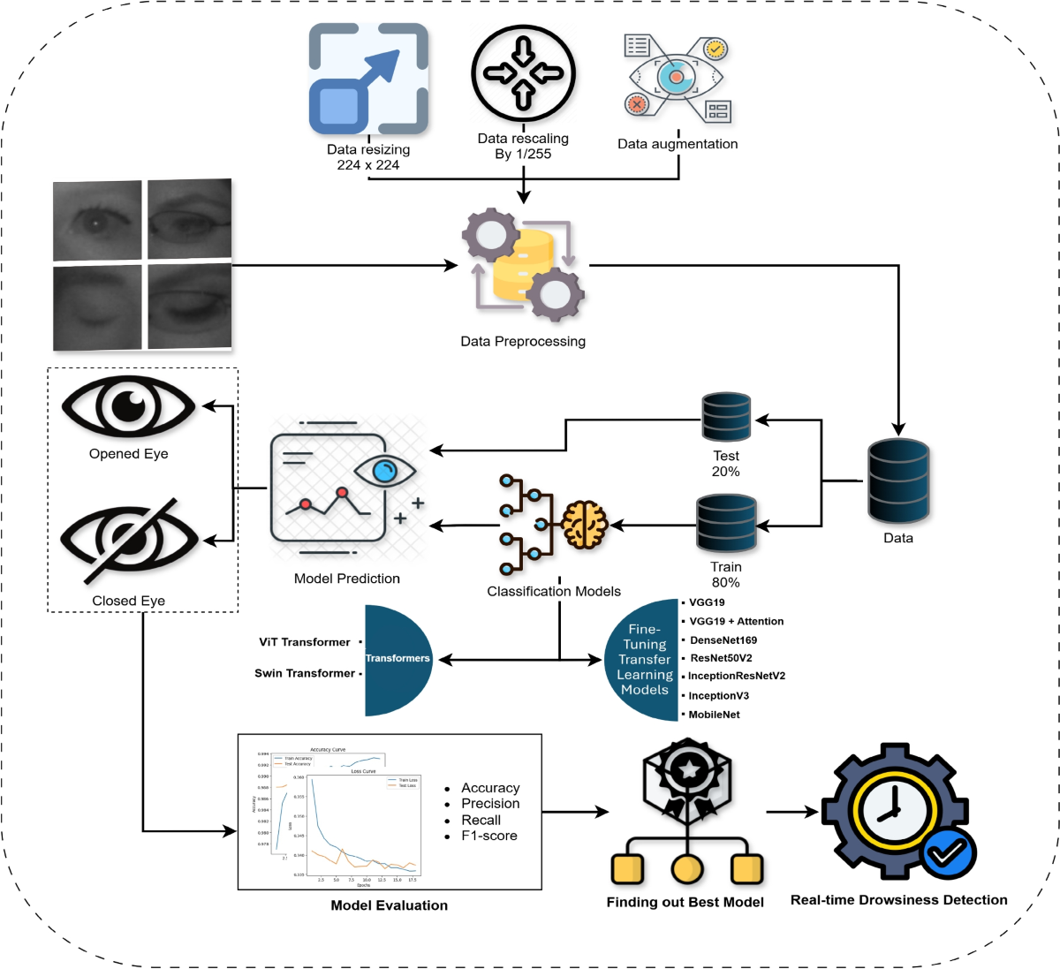
System Architecture
Input: Continuous video stream from a dashboard-mounted camera.
Processing Pipeline:
  Grayscale conversion via OpenCV for performance optimization.
  Face detection to isolate the region of interest.
  68-point facial landmark mapping using dlib.
Decision Logic: Continuous calculation of eye and mouth metrics against dynamic sensitivity thresholds.
Output: Real-time visual/audio alerts and automated event logging.

Slide 4
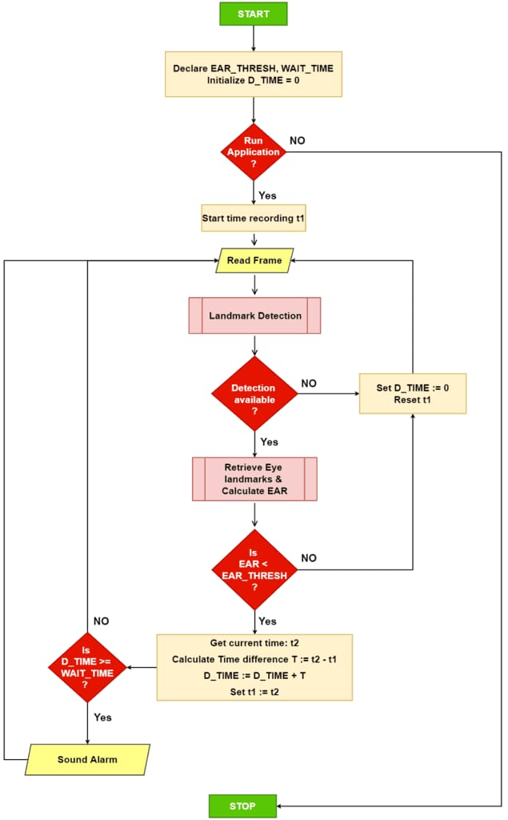
Flowchart

Slide 5

Core Mathematics - Eye Aspect Ratio (EAR)
Concept: Instead of complex image processing to determine if an eye is open, we use a scalar value based on the distances between eye landmarks.
Formula:
Explanation: The numerator calculates the vertical distance between the eyelids, while the denominator calculates the horizontal distance. As the eye closes, the EAR approaches zero.

Slide 6

Core Mathematics - Mouth Aspect Ratio (MAR)
Concept: Tracking the spatial relationship of the outer lips to detect yawning, a primary indicator of fatigue.
Formula:
Explanation: Similar to EAR, this measures the vertical opening of the mouth relative to its width. Sustained high MAR values trigger the yawn alert.

Slide 7
Technologies & Frameworks
OpenCV: For real-time video capture, image matrix manipulation, and on-screen data rendering.
Dlib: For robust, pre-trained HoG (Histogram of Oriented Gradients) face detection and shape prediction.
Python (Tkinter): Built a multi-threaded, responsive graphical user interface to separate the heavy video processing loop from the UI.
Data Handling: Implemented CSV, JSON, and HTML exporting modules for post-session safety analysis.

Slide 8
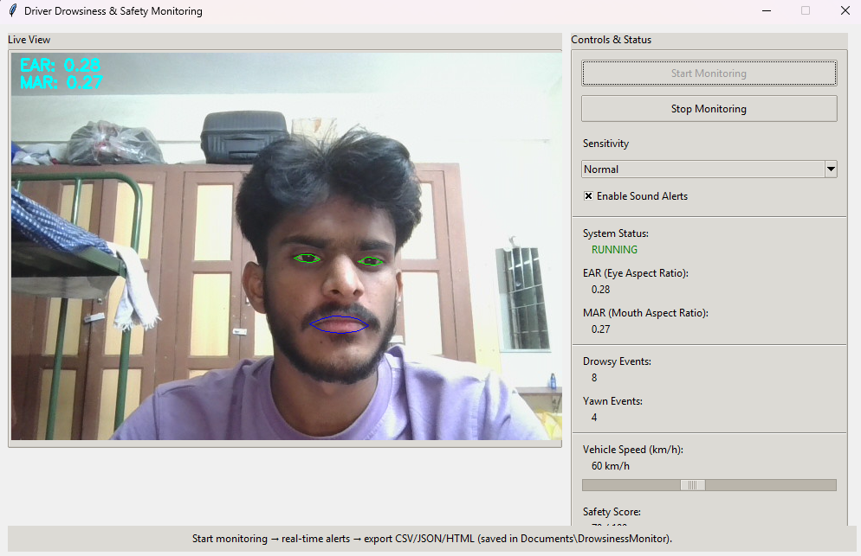
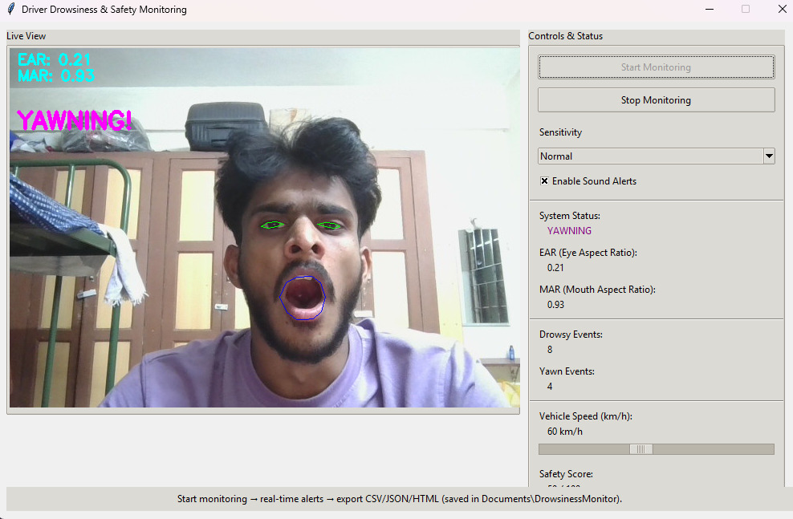
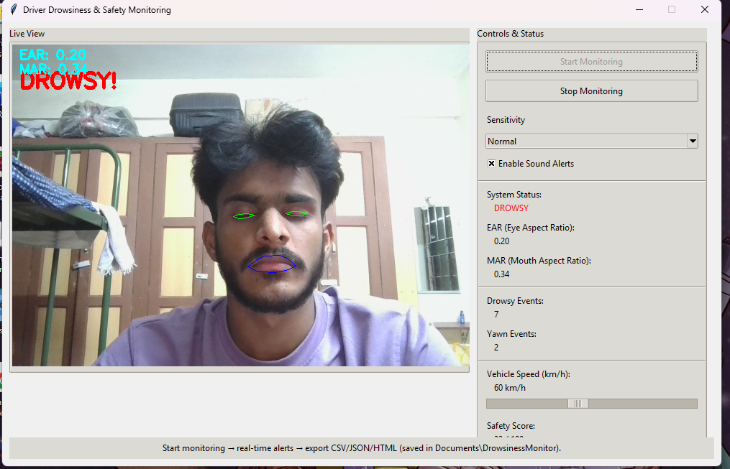
Key Features & Demo
Mouth Aspect Ratio (MAR)
Eye Aspect Ratio (EAR)
Live Metrics: Real-time display of EAR/MAR values and a dynamic "Safety Score" gauge.
Adjustable Sensitivity: Low, Normal, and High profiles to account for different drivers and lighting conditions.
Failsafes: "No Driver Detected" auto-pause functionality to prevent false positives when the camera view is obstructed.

Slide 9
Future Scope & Hardware Integration
Edge Computing Deployment: Porting the Python backend to run on an embedded device like a Raspberry Pi 5 for self-contained, in-vehicle use.
Hardware Control: Wiring the alert triggers to physical dashboard buzzers or LED arrays using GPIO pins.
Model Upgrades: Transitioning from the dlib shape predictor to a
lightweight Artificial Neural Network (ANN) to improve framerates on
resource-constrained edge devices.

Slide 10
Conclusion
The system successfully bridges software engineering with computer vision to create a scalable, data-driven safety tool.

